Slide 1
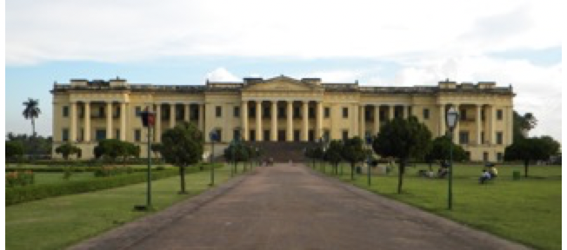
The Hazarduary Palace

Slide 2
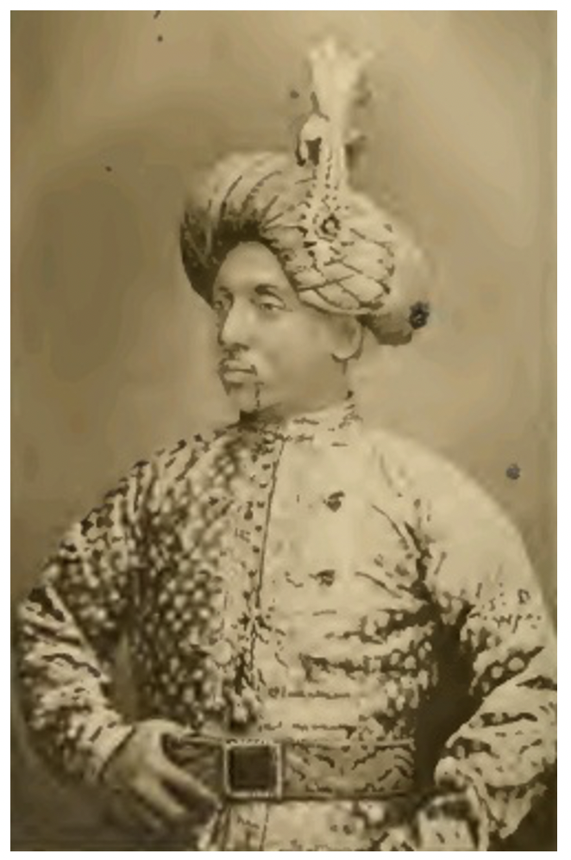

The Nawab, age about 40

Slide 3
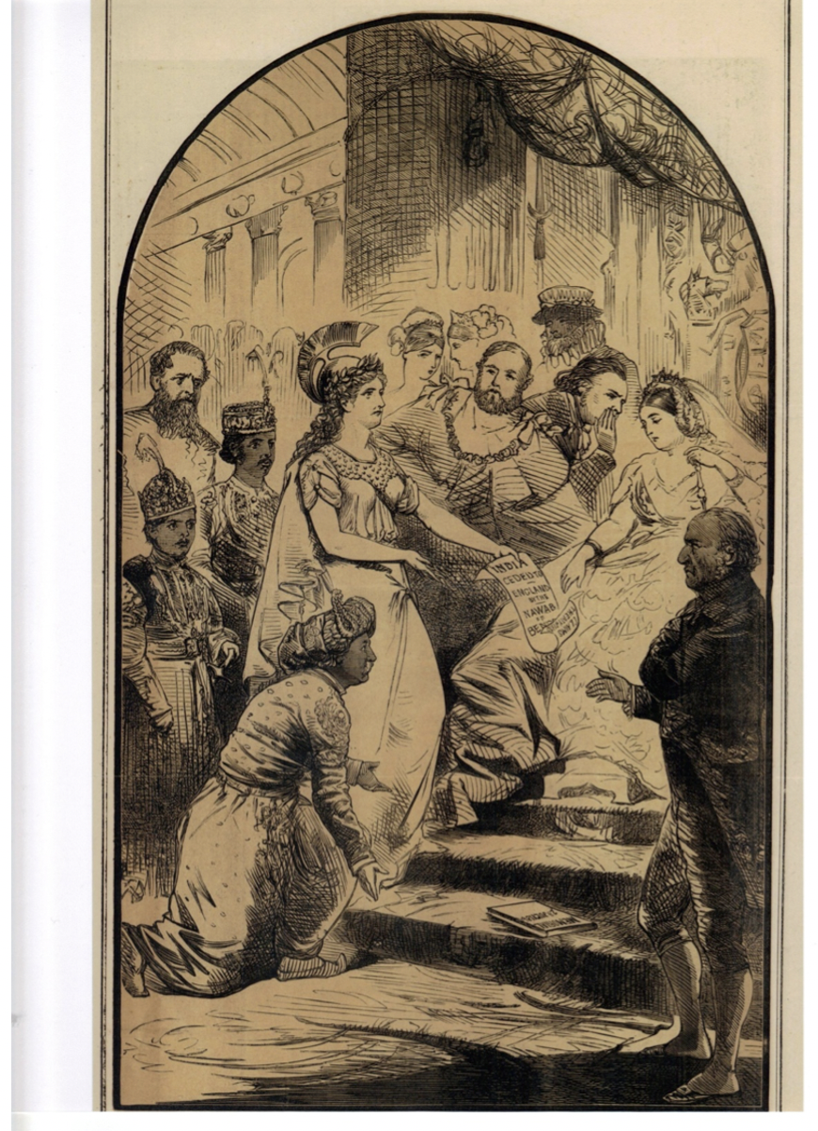
The Nawab petitioning for his rights (cartoon)

Slide 4
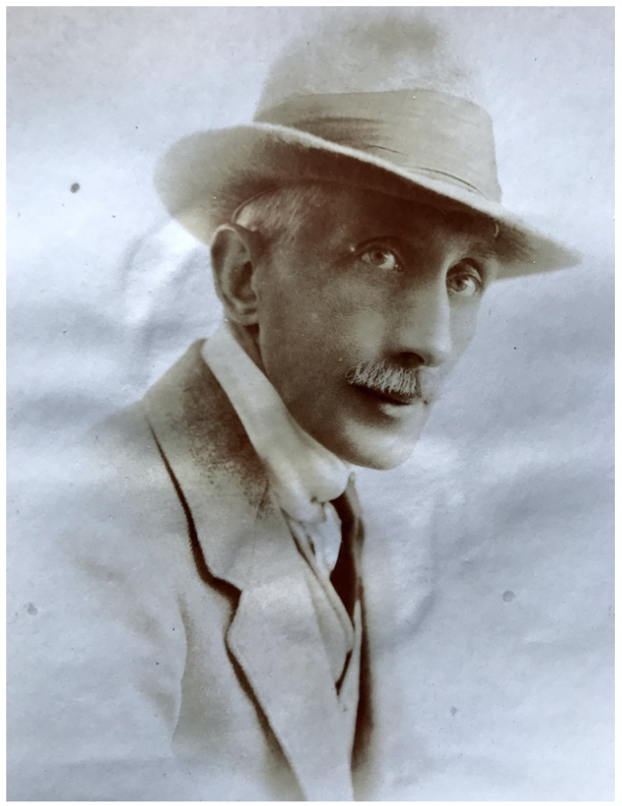
Nusrat – Lyn Innes’ grandfather

Slide 5
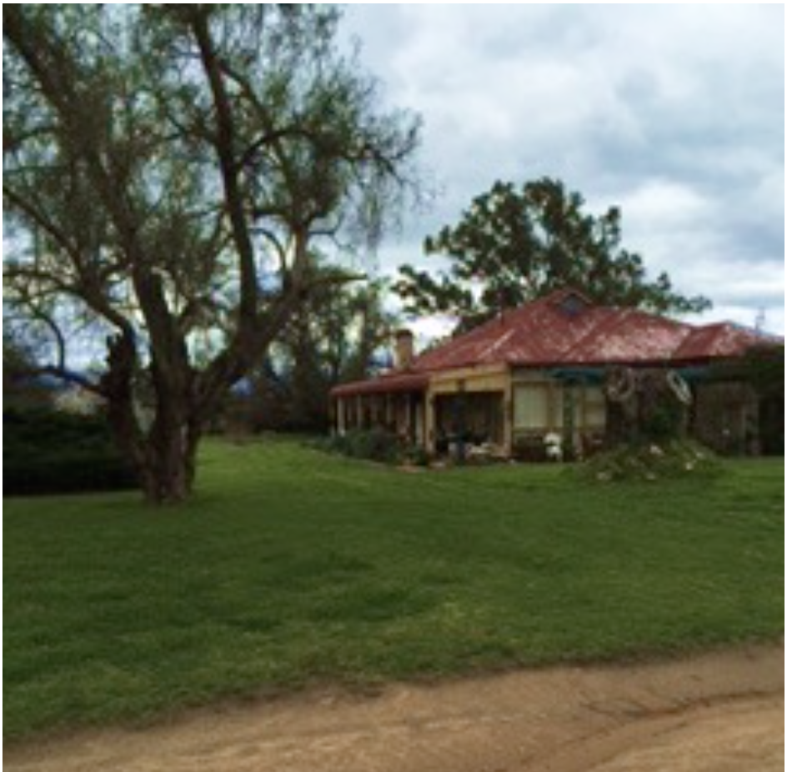
Myalla – the house and farm Nusrat bought in Australia

